Slide 1


Measurement of ions present in water Chloride (cl⁻) & Calcium (ca²⁺)
PROJECT BY:
VISHVESH PATEL → 18DCE092
MANAV SHAH → 18DCE116
VEDANT SHAH → 18DCE121
GUIDED BY:
Prof. GAURANG PATEL
Assistant Professor
Computer Science & Engineering
DEPSTAR, CHARUSAT

Slide 2
Content
Introduction
Project Definition
Abstract
Components & Connections
Requirements
Waspmote hardware
Circuit diagram
Implementation
Meshlium
Output
References

Slide 3
1.
Introduction

Slide 4
Introduction
The Smart Water model has been conceived to facilitate the remote monitoring of the most relevant parameters related to water quality.
Calcium Ion:-
Calcium is an important determinant of water harness, and it also functions as a pH stabilizer, because of its buffering qualities. Calcium is naturally present in water. It may dissolve from rocks such as limestone, marble, calcite, dolomite, gypsum, fluorite and apatite. Seawater contains approximately 400 ppm calcium, Rivers generally contain 1-2 ppm calcium.
Chloride Ion:-
Chloride increases the electrical conductivity of water and thus increases its corrosivity. Chloride concentrations in excess of about 250 mg/L can give rise to detectable taste in water, but the threshold depends upon the associated cations. Seawater can contains 20.000 ppm of this ion.

Slide 5
2. Project Definition

Slide 6
Project definition
Measurement of calcium and chloride ions percentage present in different types of water.
Using Waspmote sensors and its API to measure the concentration of the amount of chloride and calcium ions present in the water of three different amount i.e. 10ml, 100ml, 1000ml.
Also to measure the choride voltage and chlorine voltage using sensors.

Slide 7
3. Abstract

Slide 8
Abstract
The Smart Water Ions Sensor Board has been designed to facilitate the measurement of the most important chemical parameters that allow the remote monitoring of water quality in different scenarios, which includes contamination surveillance in natural environments such as rivers and lakes, control of the appropriate conditions of water in pools or fish farms, agriculture, hydroponics and observation of industrial sewage from industries.
The Smart Water Ions Sensor Board have four available sockets to connect any of the Ions Probes, and one specific socket for the Reference Probe.

Slide 9
4. Components & Connections

Slide 10
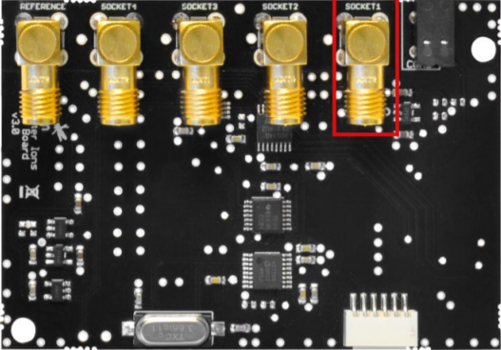
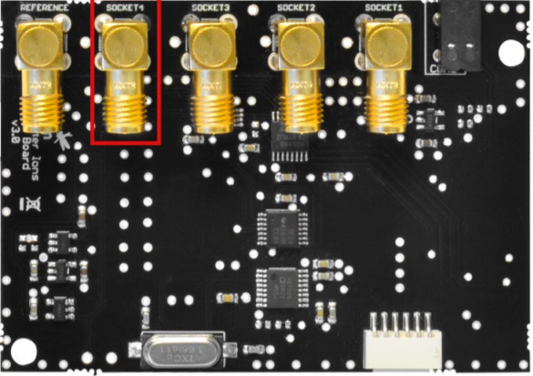
Components & Connections
The sensor board includes socket ports for connecting the Calcium and Chloride ion sensor in different sockets.
With Calcium ion sensor we need to use Single Junction Reference Probe.
With Chloride ion sensor we need to use Double Junction Reference Probe.

Slide 11
Components & Connections
After connecting the smart water ion sensor board with Waspmote kit, we can get output on the device using USB or using wifi module.
Connection would look like this:-
Volume of water can be changed between
10 ml
100 ml
1000 ml

Slide 12
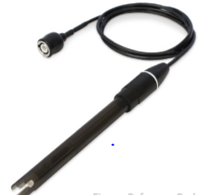
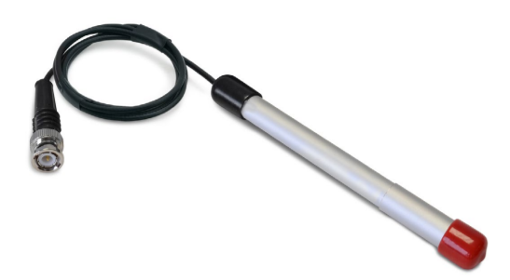
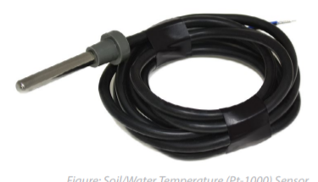
Reference Probe
Ion Sensor
Water Temperature Sensor

Slide 13
5. Requirements

Slide 14
Requirements
Hardware:-
1 x Waspmote
1 x Battery
1 x Smart Water Ions Sensor Board
1 x Calcium Sensor Probe
1 x Chloride Sensor Probe
1 x Soil/Water Temperature sensor
1 x Single Junction Reference Probe
1 x Double Junction Reference Probe
Software:-
Waspmote PRO IDE

Slide 15
6. Waspmote hardware

Slide 16
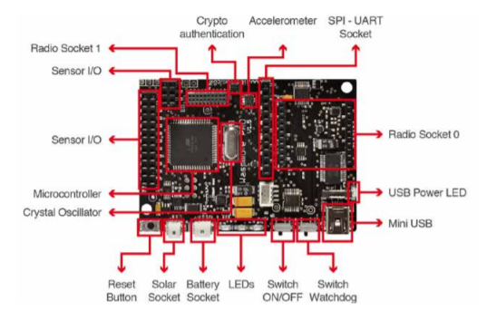
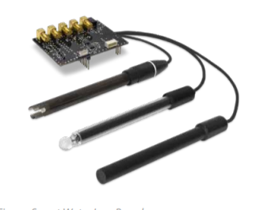
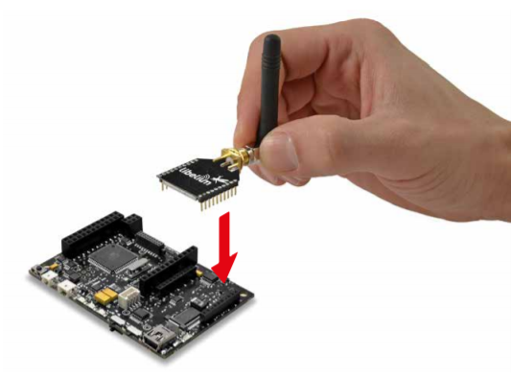

Slide 17
7. Circuit diagram

Slide 18
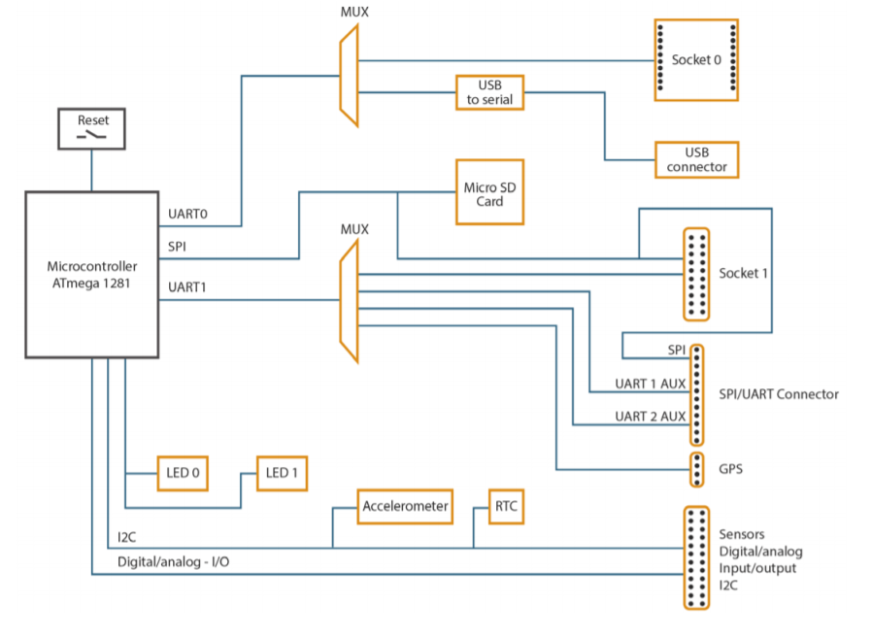
Circuit diagram of Waspmote

Slide 19
8. Implementation

Slide 20
Implementation
Turn on the Waspmote with the Smart Water Ions Sensor Board and the Calcium Ion (Ca2+), Chloride Ion(Cl⁻) Sensor Probe connected.
Upload the code of Calcium sensor to the Waspmote board and make sure of receiving the data in the serial monitor.
Pour one of the solutions in a clean beaker.
Immerse the probe in pure de-ionized water for about 30 seconds to ensure that the membranes were always in the same state at the beginning of each measurement.
Introduce the Calcium Ion (Ca2+), Chloride Ion(Cl⁻) Sensor Probe in the solution and wait for a stable output. Make sure that the sensor is completely immersed in the solution and that it is not close to the beaker wall, which may affect the field between the electrodes and disturb the measurement. Once the output is steady, annotate the value in volts obtained.

Slide 21
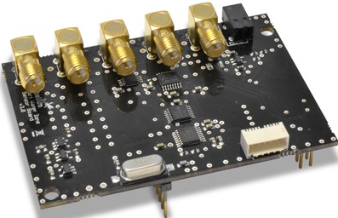
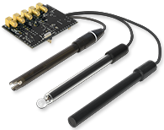
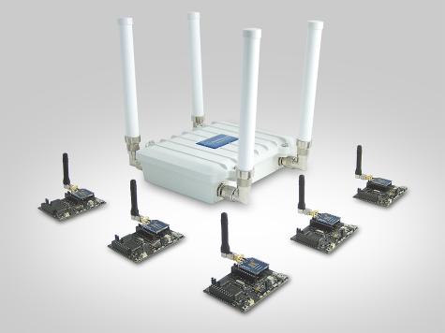
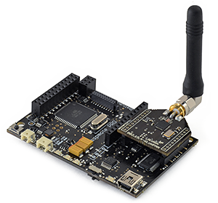
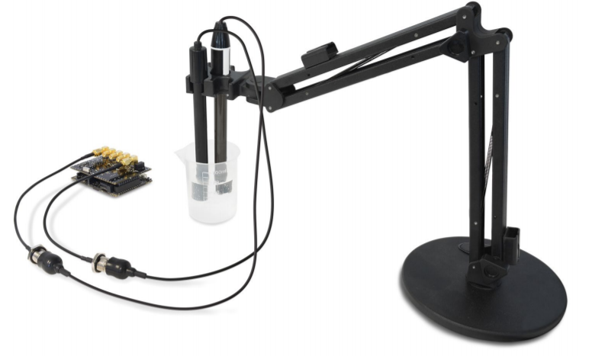

Slide 22
9. Meshlium

Slide 23
Meshlium
Meshlium is an IoT gateway that may contain up to 4 different radio interfaces: a WiFi 2.4 GHz (Access Point), 4G/3G/GPRS/GSM and 2 XBee/RF radios.
All the networking options can be controlled from the Manager System, a web interface which comes with Meshlium . It allows to control all the interfaces and system options in a secure, easy and quick way.

Slide 24
10. Output

Slide 25
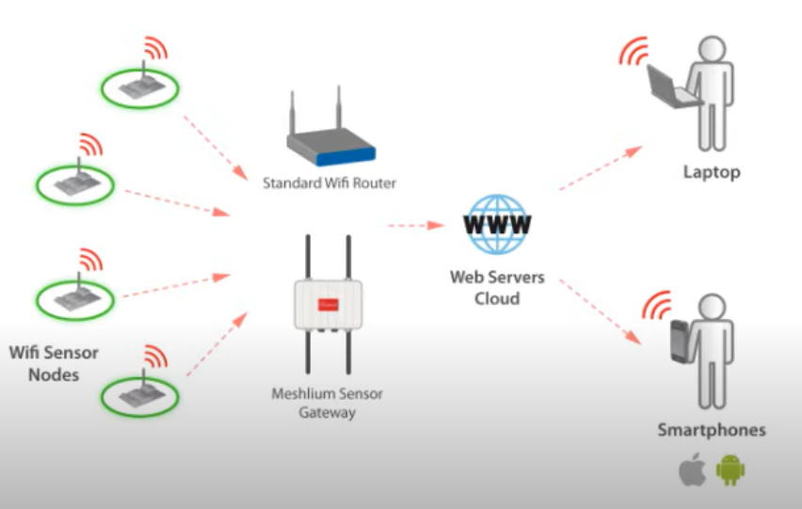
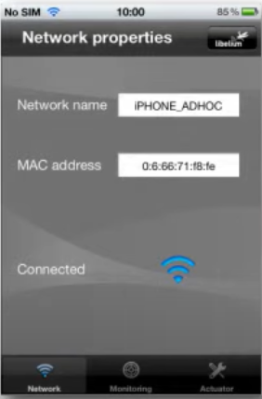
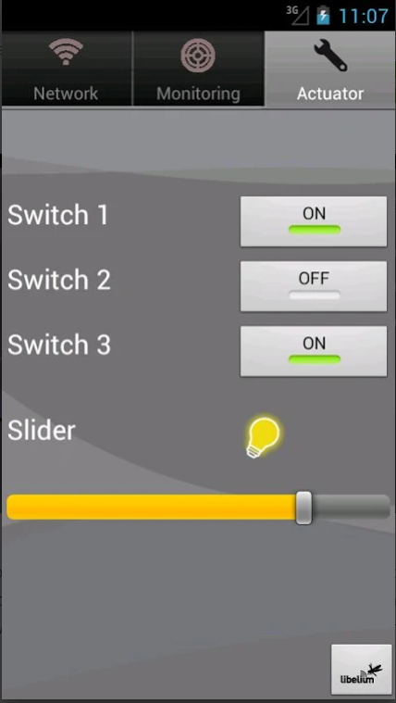
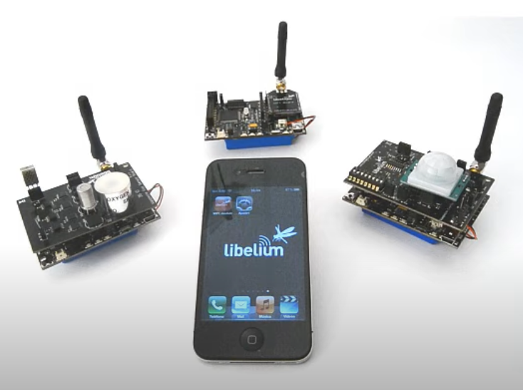

Slide 26
11. References

Slide 27
References
http://www.libelium.com/development/waspmote/documentation/smart-water-ions-board-technical-guide/
http://www.libelium.com/development/waspmote/documentation/waspmote-technical-guide/
http://www.libelium.com/development/meshlium/documentation/meshlium-technical-guide/
http://www.libelium.com/development/waspmote/documentation/waspmote-quick-start-guide/
http://www.libelium.com/development/waspmote/documentation/waspmote-datasheet/
http://www.libelium.com/development/waspmote/

